Slide 1
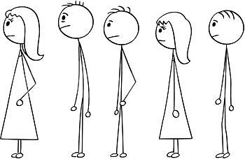
Ratnapura Teaching Hospital Solution to Patient Queuing

Slide 2
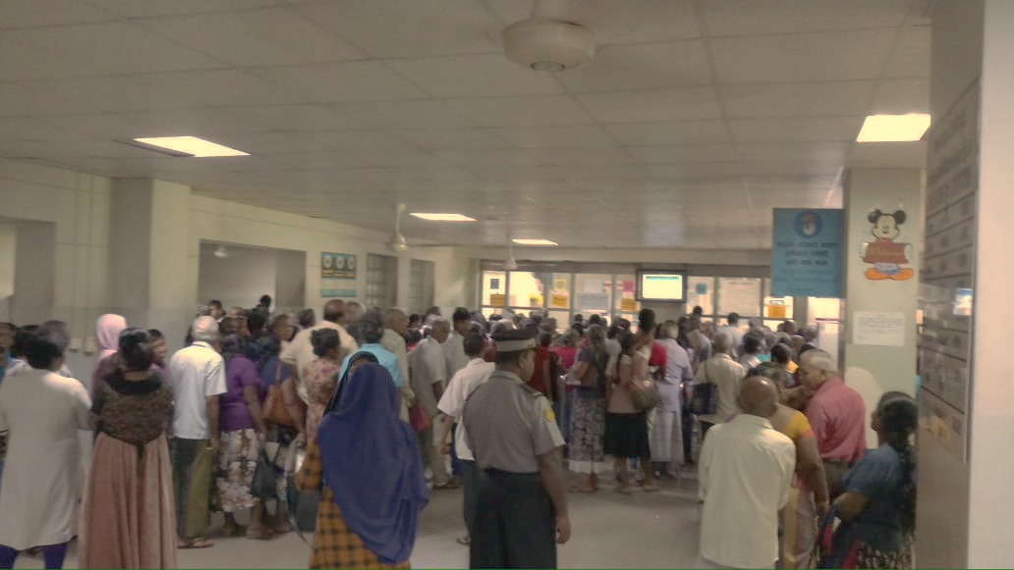
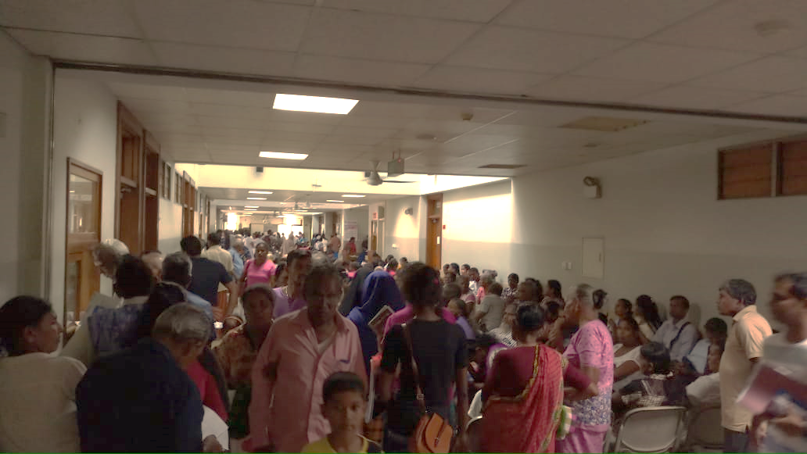
Problem
There are long queues at the pharmacy (specially for the clinical section) and patients have to wait about 3 hours at those queues.
Spacings are covered by long queues. This creates a rush in the building and obstructs other activities

Slide 3
Presently Four Steps are Involved when prescribing
Finding the clinical history register of the client
(Approx. 1 minute)
Examination by the doctor
(Approx. 2 - 5 minutes)
Providing the next clinic Date
(Approx. 20 seconds)
Prescribing the medicine
(Approx. 1-2 minutes)

Slide 4
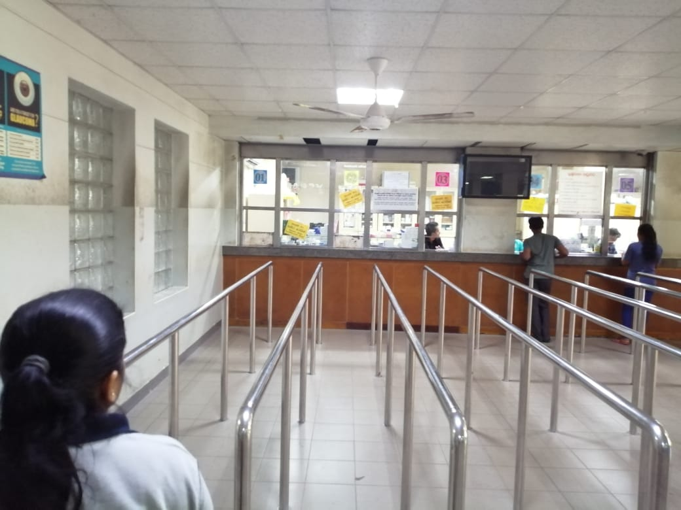
| All Clinics |Priority | Staff | OPD | Children|
1
2
3
4
5
6
7
8

Slide 5
Rathnapura Teaching Hospital – Floor plan
Lab
Pharmacy Area
OPD
Blood Sampling Center

Slide 6
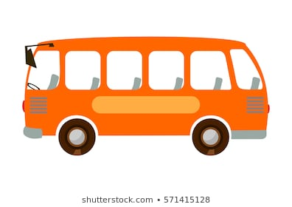

OPD Patients Movement Around the Building
Lab
Pharmacy Area
OPD
Blood Sampling Center

Slide 7
Isolated Area
Lab
OPD
Blood Sampling Center
Blood Draw
Reduce the rush in the building

Slide 8
Proposed Solutions
Phase 1:
Introduction of Numbering System and Displaying at Counters
Temporary Resting Area
Phase 2:
Linking of Stores Database to Prescription and Pharmacy Sections

Slide 9
Phase 1- Introduction of Numbering System and Displaying at the Counters
Numbers for these 4 Clinic Counters
Existing System
| All Clinics | Priority | Staff | OPD | Children|
1
2
3
4
5
6
7
8

Slide 10
Use disposable (printed) number chits
Each clinic is given a bundle of chits with seal and date
Once all medicines for a patient are prescribed on the chit, it is handed over to the patient at the particular clinic
Since common numbering system is used, Numbers(1-1000) are divided among the clinics
This division of numbers should be fair. More crowded clinics should get numbers more frequently

Slide 11
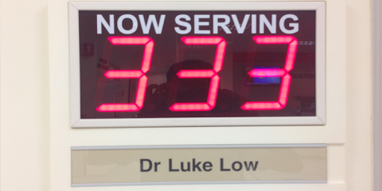
Common Number for First 4 Counters
1
2
3
4

Slide 12
Advantages of Common Numbering
Teaching Hospital Rathnapura
Roughly 120-140 patients per hour
Average of packing time for all clinics
Simple for patients
Easy to predict the time
(Multiple Clients –Single Server Model)
Our next step is to predict the time
Clinic Dispensary
275
Predicted Time
1 : 10 – 1: 20pm

Slide 13
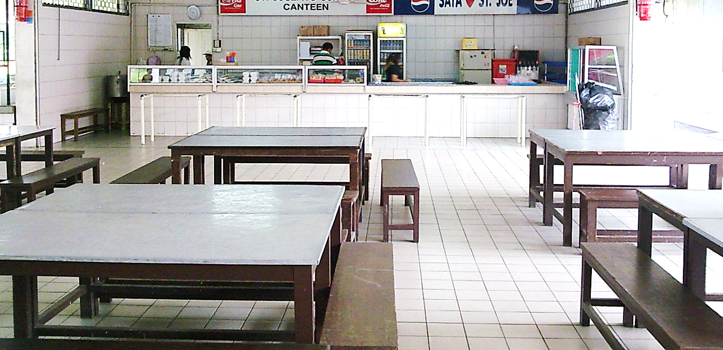
Phase 1- Temporary Resting Area
Additional Temporary Resting Area….
outside the main building …
a spacious canteen …
It is better to fix a display
in the resting place as well

Slide 14
Proposed Numbering System Explained
1
2
3
4
Display Number
40
Patients’ Numbers <40

Slide 15
Proposed Numbering System Explained
1
2
3
4
Display Number
41

Slide 16
Proposed Numbering System Explained
1
2
3
4
Display Number
41

Slide 17
Distribution of Numbers Among Clinics
Numbers | Clinic
Cardiology | 1-5
Kidney | 6-10
Skin | 11-15
Kidney | 16-20
Neuro | 21-25
Cardiology | 26-30
Kidney | 31-35
Skin | 36-41
Kidney | 41-45
ENT | 46-50
Cardiology | 51-55
Kidney | 56-60
Clinic | No. of Patients per day(not real)
Cardio | 200
ENT | 100
Skin | 200
Kidney | 400
Neuro | 100

Slide 18

Questions?

Slide 19
Phase 2: Linking a Database
Introduce a Doctor, Pharmacists communication system
Instead of the cardboard prescription
Special arrangement
Isolate OPD and Clinics
Add separate Pharmacies to the Clinic

Slide 20


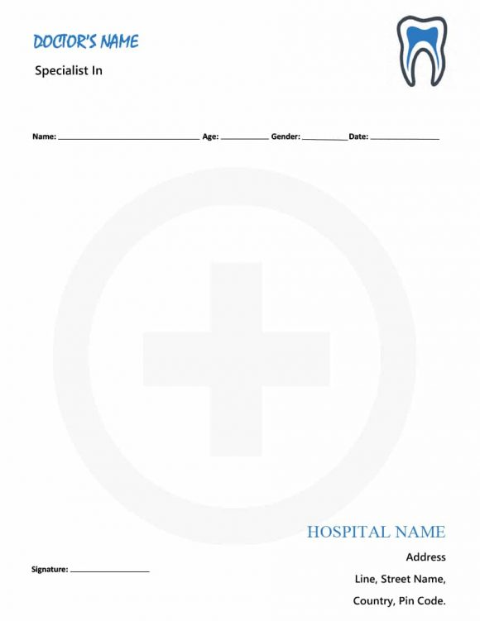


Doctor-Pharmacist Communication System
Real time process
Clinic 1
Clinic 2
OPD
Clinic Name
Index
Name of the Patient
Medicine
Pharmacy
Clinic 3
Clinic 5
Clinic 4

Slide 21
How this increase efficiency …
Since prescriptions are delivered in real time, medicine can be picketed while the patient come to the counter
As an option we can use all the pharmacist to packet medicine and use some other laborer just to give these packets to correct patients.

Slide 22
Once a database is in place, steps are reduced to:
Finding the clinical history register of the client
Examination by the doctor
Providing the next clinic Date
Prescribing the medicine

Slide 23
Karapitya Teaching Hospital
OPD & Clinic Section
Laboratory
OPD counter and Dispensary
OPD Rooms
OPD Surgery Room
OPD – Children
Dispensary – Cardiology/Kidney
Dispensary- Fever
Clinic
Seating area
Ground floor
Isolated OPD

Slide 24

Thank you..!

